Slide 1
Dimensionality Reduction

Slide 2
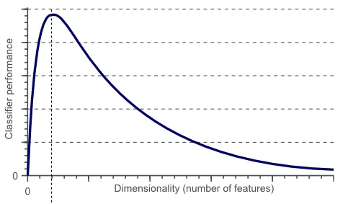
Dimensionality Reduction
According to Hughes phenomenon, If the number of training samples is fixed and we keep on increasing the number of dimensions then the predictive power of our machine learning model first increases, but after a certain point it tends to decrease.

Slide 3
Dimensionality Reduction
Dimensionality Reduction refers to the technique that reduces the numbers of features in a dataset.
Why Dimensionality Reduction?
Less dimensions for a given dataset means less computation or training time. (low model complexity)
Data compression.
It helps to find out the most significant features and skip the rest.
Lead to better human interpretation and visualization.
In short, its main focus is to reduce curse of dimensionality.

Slide 4
Dimensionality Reduction
Two types of Dimensionality Reduction techniques:
Feature Selection
Feature Extraction

Slide 5
Principal Component Analysis (PCA)
Principal Component Analysis (PCA) is a linear dimensionality reduction technique.
PCA transforms higher dimensional data to lower dimensions.
Why PCA?
Low model complexity, Faster training, reduce computational cost.
Better interpretation and visualization. For example transform 10-dimensional data to 2D or 3D.

Slide 6
Principal Component Analysis (PCA)
Principal Component Analysis (PCA) is a linear dimensionality reduction technique designed to extract a new set of features from an existing high-dimensional dataset. And selects features from new set which are more important. Its primary goal is to reduce the dimensionality of the data while preserving as much information (variance) as possible.

Slide 7
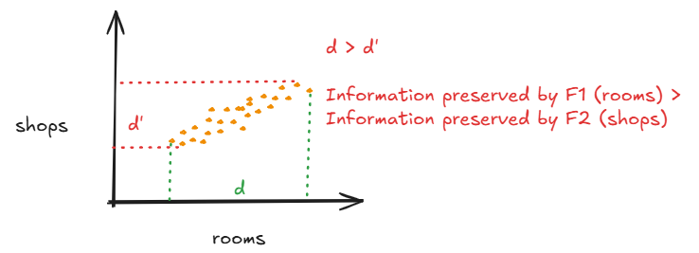
Principal Component Analysis (PCA)
Consider a dataset:
No. of rooms | No. of shops | Price
3 | 1 | 60
4 | 0 | 130
5 | 6 | 170
2 | 10 | 90

Slide 8
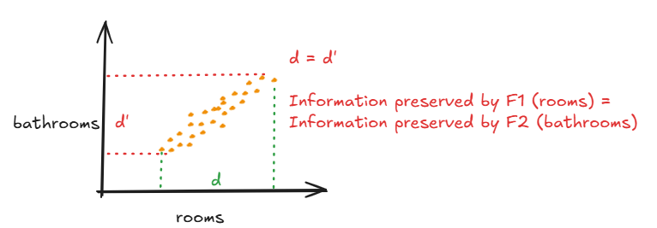
Principal Component Analysis (PCA)
Consider another dataset:
No. of rooms | No. of bathrooms | Price

Slide 9
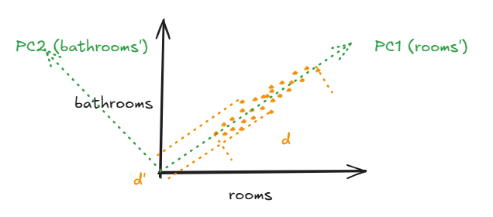
Principal Component Analysis (PCA)
Now if we want to reduce the dimensions of the data from 2D to 1D, we cannot drop one feature as we lose a lot of information.
Variance (information preserved) by principal component PC1 is greater then the information preserved by PC2. So, PC1 is selected as the feature.

Slide 10
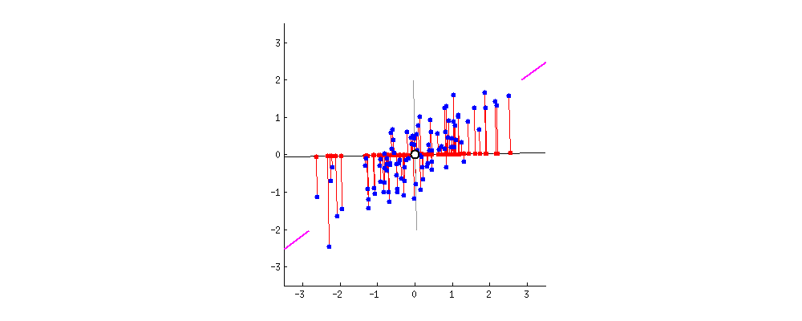
Principal Component Analysis (PCA)
https://builtin.com/data-science/step-step-explanation-principal-component-analysis

